Slide 2
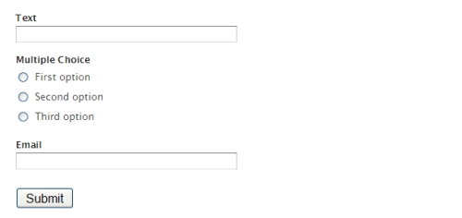
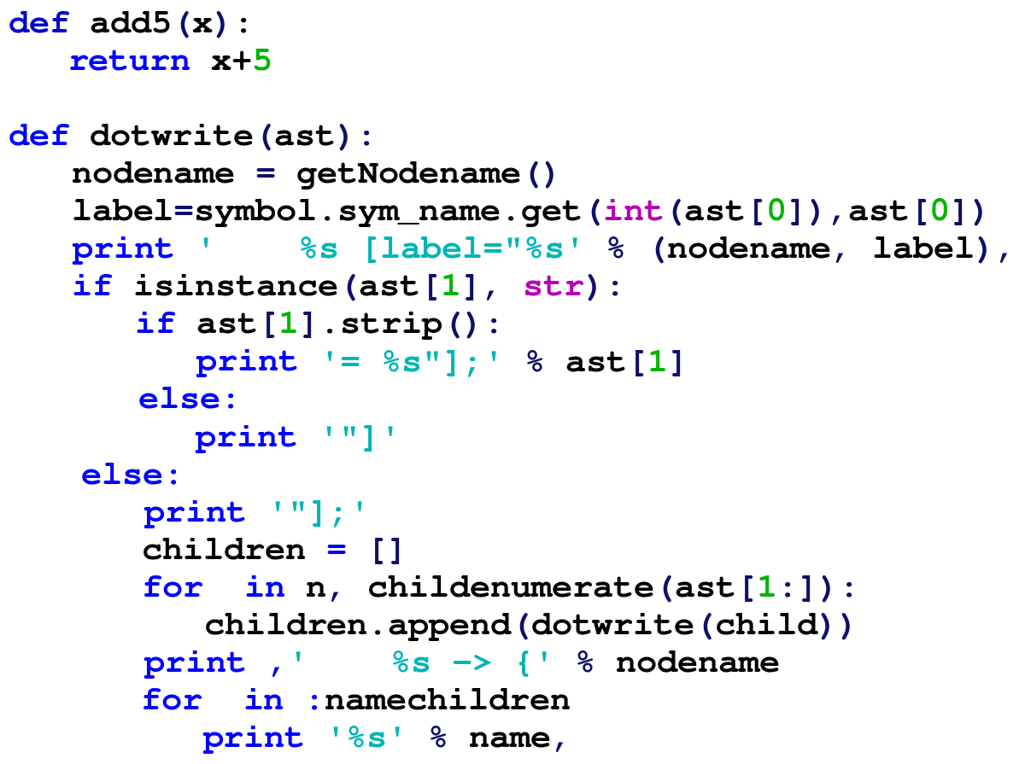
Input Validation
Ensure date inputs are valid
Syntactic validation
Semantic validation
Use of schemas
Notes:
Syntactic Validation = (Input types and lengths, think SSN, date, currency or symbols
Semantic Validation = (Valid in the application context such as a start date)
JSON schema – defines the structure, content
XML schema – describes the elements, attributes and data types

Slide 3


Blacklisting and Whitelisting
Blacklisting
Banning characters
Hard to maintain
Whitelisting
Acceptable character list
Can break something
Notes:
Stored Procedures

Slide 4
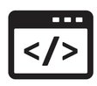
HTTP Headers
Can be used to upload files
XSS attacks
Leaked information
Internal hostnames
Backend servers/applications
HTTP security headers
X-Frame-Options
X-XSS-Protection
X-Content-Type-Options
Notes:
Counter Mode Cipher Block Chaining Message Authentication Code Protocol and AES

Slide 5
Code Signing
Software author
Code integrity
Uses certificates
Digital signatures
Notes:
Simultane

Slide 6
Secure Cookies
Do not include/store sensitive information
HTTPS vs. HTTP
Secure cookie flag
Cookie integrity
Can be bypassed
Notes:
Identity to remote users/computers

Slide 7
Static Code Analysis
Automated scan
Code/software in not running
Good for source code
Early detection is SDLC
Notes:
Identity to remote users/computers

Slide 8
Dynamic Code Analysis
Automated scan
Code/software is not running
Analyzing code behavior/interaction
Early detection is SDLC
Notes:
Identity to remote users/computers

Slide 9
Manual Code Analysis
Slow process
Not automated
Line by line analysis
Open to interpretation
Notes:
Introduced the human element

Slide 10
Fuzzing
Automated process
Inputs
Random data
Invalid data
Unexpected data
How does the software respond?
Error messages
Memory leaks
Crashes
Buffer overflow
Notes:
Introduced the human element

